Slide 1
LIVE CURRENT DETECTOR AC(OR)DC POWER SUPPLY
AIM: To identify the presence of electrical current in a circuit or wire without direct contact.

Slide 2
ABSTRACT
A live current detector, based on electromagnetic induction, detects electrical current in a circuit or wire without direct contact. It is essential for safety and fault detection.
A Live Current Detector, also recognized as a non-contact voltage tester or current detector, stands as a paramount device in electrical safety and diagnostics. This compact and portable instrument employs the principles of electromagnetic induction to identify the presence of electric current in a circuit or wire without requiring direct contact. The detector not only signals the existence of alternating current (AC) or direct current (DC) but also provides a means to gauge the magnitude of the current flow. This innovative technology finds applications across diverse settings, enhancing safety, and expediting fault detection. The Live Current Detector emerges as an indispensable tool in ensuring the secure operation and maintenance of electrical systems.

Slide 3
INTRODUCTION
Compact and portable, the live current detector identifies electric current without contact. It uses electromagnetic induction for reliable detection in various settings.
In the dynamic realm of electrical systems, the Live Current Detector takes center stage as a pivotal device designed to revolutionize safety and diagnostics. This compact and portable instrument represents a breakthrough in identifying the presence of electric current within a circuit or wire, all without the necessity for direct physical contact. Rooted in the fundamental principles of electromagnetic induction, the Live Current Detector offers a reliable means of detecting live currents in a variety of settings.
The essence of the Live Current Detector lies in its ability to transcend the limitations of traditional methods by providing a non-intrusive approach to current detection. By harnessing electromagnetic induction, this device becomes an indispensable asset for electricians, maintenance personnel, and individuals involved in electrical systems. It not only serves as a guardian of safety by identifying the presence of alternating current (AC) or direct current (DC) but also plays a crucial role in monitoring and controlling the flow of current.

Slide 4
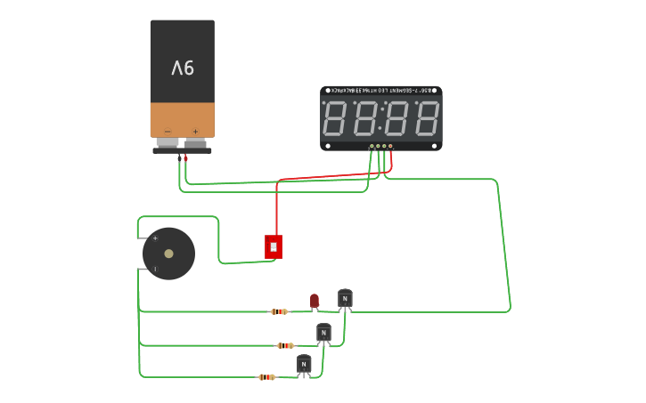
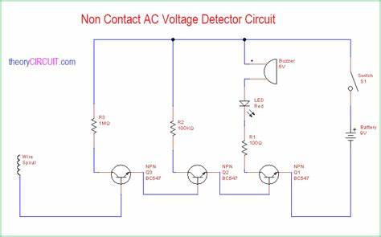
BLOCK DIAGRAM

Slide 5
ADVANTAGES
Fault Detection:
The Live Current Detector serves as a vigilant guardian, swiftly identifying faults or abnormal conditions by monitoring the flow of current. Sudden spikes or drops in current can be indicative of underlying issues within the circuit.
Overcurrent Protection:
An essential component in overcurrent protection systems, the detector promptly identifies excessive current flow and triggers protective measures. This includes shutting down the power supply to prevent potential damage to connected equipment.
Energy Efficiency:
The ability to monitor current consumption empowers users to optimize power usage and reduce waste, particularly in applications where energy conservation is paramount.
Safety:
Contributing to electrical safety, the Live Current Detector provides a means to monitor and control the current flowing through a system. This is crucial in situations where high currents could pose risks to both equipment and personnel.

Slide 6
Real-time Monitoring:
Enabling real-time monitoring of current flow, the detector allows for precise control and management of power systems. This capability is particularly beneficial in industrial applications where maintaining optimal current levels is imperative.
Diagnostic Information:
Beyond mere detection, the Live Current Detector offers diagnostic insights into the health of a system. Analysis of current patterns can unveil potential issues such as component degradation or impending failures.
Compatibility with AC or DC:
Tailored to specific needs, some detectors are designed to work with either AC or DC systems. This ensures accurate measurements and optimal functioning in the intended application.
Ease of Use:
Characterized by compactness, portability, and user-friendly interfaces, these detectors are convenient for electricians and maintenance personnel. They may come in handheld forms or be integrated into other tools for seamless operation.
Quick Fault Identification:
Rapid identification of the presence of current allows electricians to pinpoint faulty areas in a circuit without the need for extensive troubleshooting. This expedites the diagnosis and resolution of issues.

Slide 7
DISADVANTAGES
Limited Accuracy:
Live Current Detectors may exhibit limitations in terms of accuracy, especially when compared to more precise measurement instruments. They are generally designed for quick identification of the presence of current rather than precise current measurement.
Sensitivity to Environmental Factors:
Some detectors may be sensitive to environmental conditions such as temperature, humidity, or the presence of other electromagnetic fields. These factors can potentially affect the accuracy and reliability of the detector.
Detection Range Limitations:
Live Current Detectors may have specific detection range limitations. It's crucial to choose a detector with an appropriate range for the application. In some cases, they may not be suitable for detecting very low or very high currents.

Slide 8
Inability to Measure Current Magnitude:
While adept at indicating the presence of current, Live Current Detectors may not provide information about the magnitude of the current. This limitation can be a drawback in situations where precise current measurements are necessary.
Interference from Nearby Conductors:
Proximity to other conductors carrying current can potentially cause interference with the operation of Live Current Detectors. The detectors may give false positives or negatives if influenced by nearby electrical sources.
Variability in Sensing Technologies:
Different Live Current Detectors use various sensing technologies (inductive, capacitive, etc.), and the effectiveness of these technologies can vary based on the specific application. Choosing the right type for a particular situation is crucial.
Cost:
High-quality Live Current Detectors with advanced features may come with a higher cost. Depending on budget constraints, organizations or individuals may need to balance cost considerations with the required functionality.

Slide 9
APPLICATIONS
Electrical Maintenance and Troubleshooting:
Electricians use Live Current Detectors to swiftly identify live wires and troubleshoot electrical issues without making physical contact with the conductors, ensuring safety during repairs or maintenance activities.
Residential Electrical Work:
In residential settings, Live Current Detectors are commonly used to identify live wires when installing or repairing electrical outlets, switches, light fixtures, and other devices, ensuring power is turned off before work begins.
Commercial and Industrial Electrical Work:
Electricians and maintenance personnel in commercial and industrial settings utilize Live Current Detectors for tasks such as equipment maintenance, circuit testing, and identifying live wires in complex electrical systems.

Slide 10
HVAC (Heating, Ventilation, and Air Conditioning) Systems:
Technicians working on HVAC systems use Live Current Detectors to check for the presence of electrical voltage in components like thermostats, relays, and other electrical elements, ensuring safety during maintenance or repairs.
Automotive Electrical Systems:
Automotive technicians employ Live Current Detectors when working on the electrical systems of vehicles. They can identify live circuits in components such as batteries, fuses, and wiring without direct contact.
Construction and Building Inspection:
During construction and building inspections, Live Current Detectors are used to verify the absence of voltage in specific areas before drilling, cutting, or conducting any work that may involve the risk of electrical contact.
Safety Checks in DIY Projects:
Individuals undertaking do-it-yourself (DIY) electrical projects at home can use Live Current Detectors to check for live wires before making changes to the electrical system, enhancing safety for DIY enthusiasts without professional training.
Emergency Response:
Emergency responders, such as firefighters or rescue personnel, may use Live Current Detectors to identify live electrical sources during emergencies, ensuring a safer environment for rescue operations.
Electrical Inspections and Compliance:
Live Current Detectors play a crucial role in electrical inspections to verify the absence of voltage in specific circuits or equipment, ensuring compliance with safety regulations and standards.
Low Voltage Circuits:
Live Current Detectors are not limited to high-voltage applications. They can also be used in low-voltage circuits, such as those found in electronic devices, to identify live components without making direct contact.

Slide 11
CONCLUSION
In conclusion, the Live Current Detector stands as an indispensable innovation in the realm of electrical safety and diagnostics. By harnessing the principles of electromagnetic induction, this compact and portable device has transformed the way we approach current detection, eliminating the need for direct contact and ushering in a new era of efficiency and safety.
The advantages of the Live Current Detector, including its fault detection capabilities, role in overcurrent protection, contribution to energy efficiency, and real-time monitoring features, position it as a crucial tool for professionals in various industries. Its compatibility with both AC and DC systems, ease of use, and quick fault identification further enhance its appeal as an essential companion in electrical applications.

Slide 12
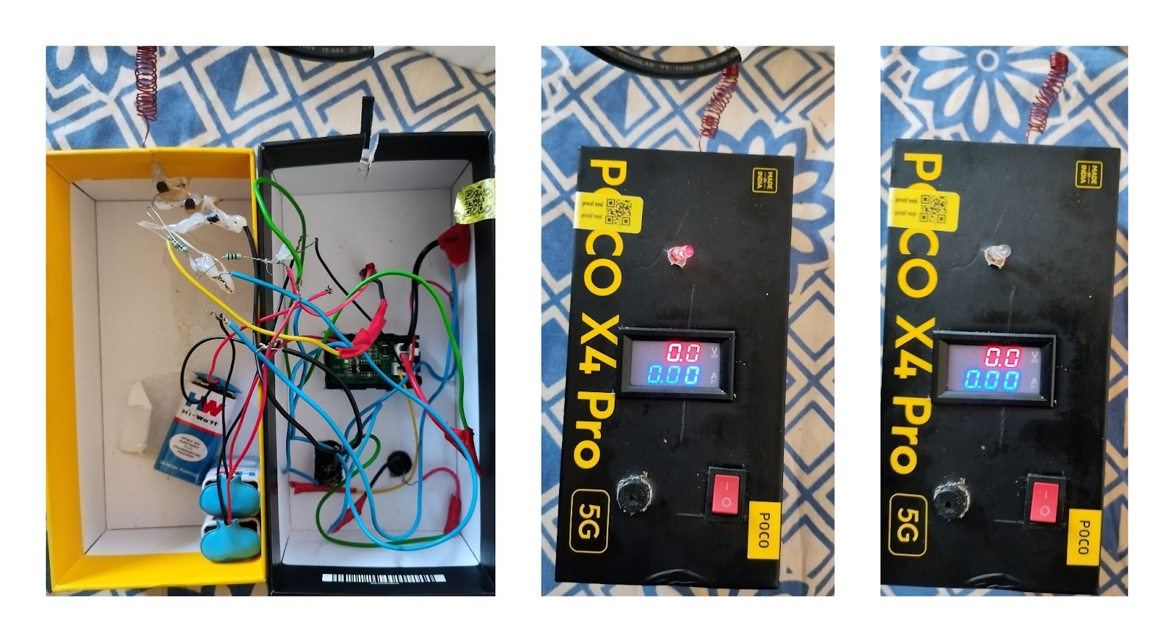
RESULT
The Implementation of a Live Current Detector (LCD) in electrical systems involves the use of advanced sensor technology to detect and monitor live currents The Implementation of a Live Current Detector (LCD) in electrical systems involves the use of advanced sensor technology to detect and monitor live currents. The key results and observations of the live current detection process are typically reflected in the readings provided by a voltmeter connected to the LCD. Here, we discuss the outcomes and observations based on the voltmeter readings:
. The key results and observations of the live current detection process are typically reflected in the readings provided by a voltmeter connected to the LCD. Here, we discuss the outcomes and observations based on the voltmeter readings:

